Slide 1
Simulation Ion beam sputtering processes
Anindit Das
(2011021)
School of Physical Sciences

Slide 2
Theory of Sputtering

Slide 3
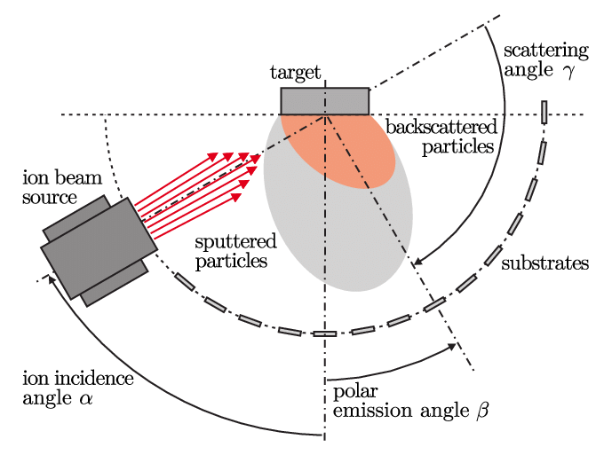
Ion beam sputtering (IBS) is a physical vapor deposition (PVD) technique used for the deposition of thin films onto solid surfaces. In IBS, a high-energy ion beam is directed towards a target material, causing atoms or molecules to be ejected from the target surface. These ejected species then condense onto a substrate placed in proximity, forming a thin film.
Mechanism
Ion Generation: In a plasma chamber, a gas like argon is ionized using RF or DC discharge methods, generating a plasma containing positively charged ions.
Ion Acceleration: The ions are accelerated to high velocities through electrodes or magnetic fields, forming a focused beam aimed at the tar get material.
Target Bombardment: Accelerated ions collide with the target material’s surface, transfer ring kinetic energy to surface atoms and causing their ejection through a process known as sputtering.
Material Ejection: Atoms from the target material are ejected into the vacuum chamber, dispersing in various directions and potentially depositing onto nearby surfaces, including substrates for thin film deposition.

Slide 4
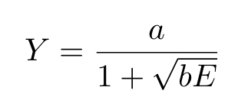
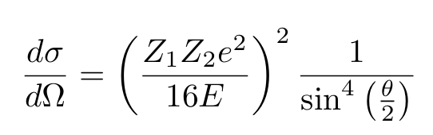
The sputtering yield (Y ) is a crucial parameter in ion beam sputtering, representing the average number of atoms sputtered per incident ion. The Yamamura formula is a widely used empirical expression for calculating the sputtering yield, given by:
Backscattering, a phenomenon where incident ions are reflected back from the target surface without causing sputtering, can be mathematically described using the Rutherford scattering formula:

Slide 5

Numerical Implementation
The sputtering yield (Y) can also be calculated numerically using collision cascade simulations and considering the target material’s surface binding energy (Eb). In such simulations, energetic ions collide with the target material, creating a cascade of atomic collisions resulting in atom ejection from the surface. The sputtering yield can be approximated by the ratio of the number of atoms sputtered (Ns) to the number of incident ions (Ni):

Slide 6
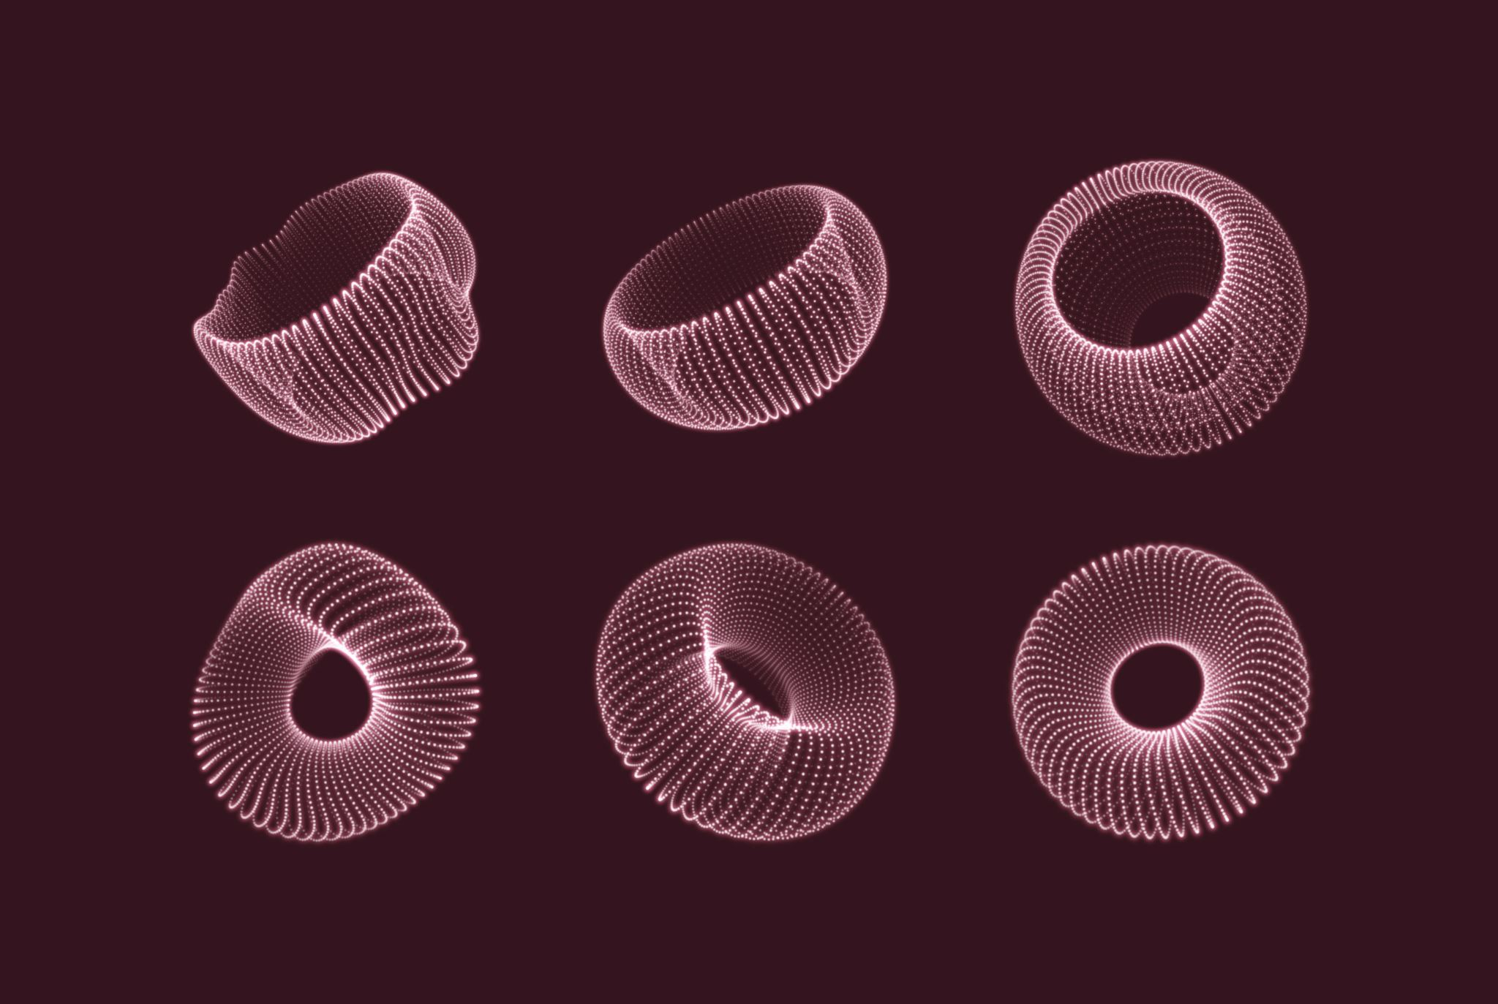
Computational models
Static Model Vs RustBCA
Static-Dynamic Hybrid Model (roadmap only)

Slide 7
Static Model implementation
Process: Ti atoms sputtered using Ar ions
Find the energy distribution of sputtered atoms
1
Count the particles which reach the intended target and plot the trajectories.
6
Find number of sputter atoms from number of ions and yield.
3
Initialize particle parameters like energy from the first step and velocities.
4
Calculate the sputter yield from the collision cascade
2
Initialize the positions and perform simulation, keep track of particles.
5

Slide 8
Approximations
Model is based on Binary Collision Approximation when dealing with interactions between two particle interactions.
Approximations used in the model are:
The energies of the sputtered particles are assumed to be in a Lorentzian distribution.
The collision cascade occurring at the surface of the lattice is assumed to be 2D in nature and the probability of the cascade steps continuing is determined by a random number generator and the fraction : Eb/Ei.
The ion which is affected by the cascade is assumed to move one step only.
The fraction of transferred energy is assumed to be same for each collision in a cascade.
The code assumes that an atom is sputtered if the energy it receives in a collision is greater than or equal to the surface binding energy.
The code assumes that the distribution of ions would be uniform during collision cascade process.
The backscattering plots are not generated using data from the model instead they are generated from independent parameters.

Slide 9
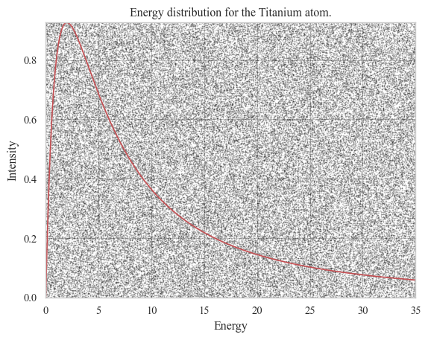
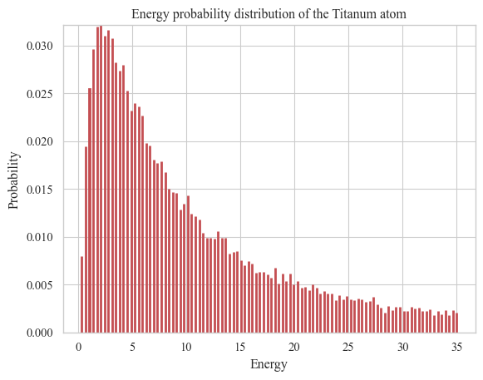
Energy distribution of Ti atoms
The Lorentzian distribution models the wide range of possible energy transfers during a collision.
It captures the skewness in the distribution of ejection angles of sputtered particles.
It accounts for multiple scattering events within the target material before ejection.
It models complex surface effects such as re-deposition, surface roughness, and surface binding energy

Slide 10
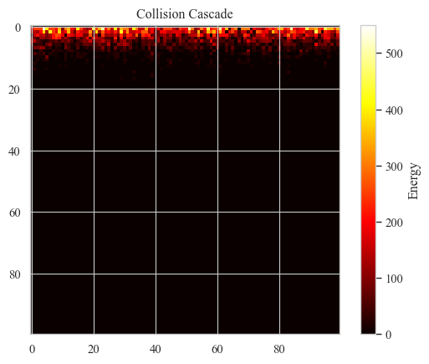
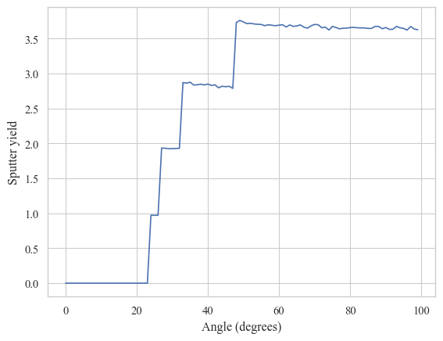
Collision cascade

Slide 11
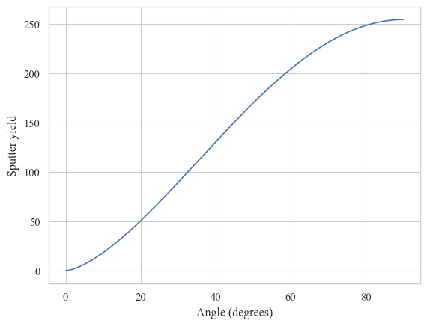
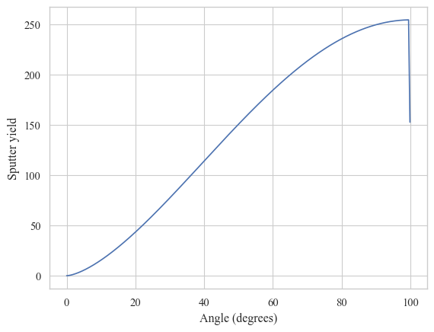
Yamamura formula
Moving average of 10 on Collision cascade

Slide 12
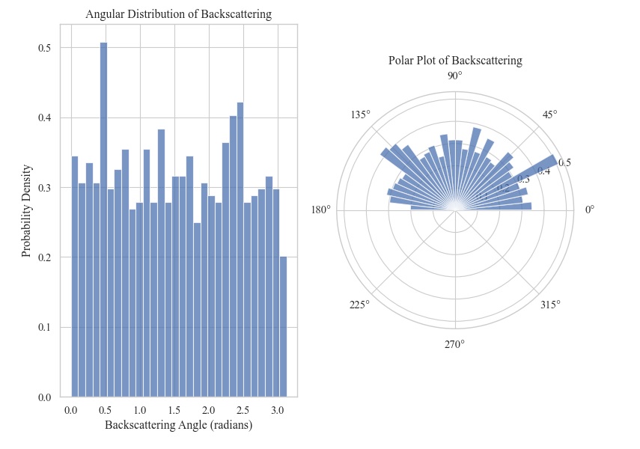
The initial direction of each ion is assumed to be uniformly distributed between 0 and π, ignoring potential influences like ion source design and target alignment.
Energy loss is calculated as a fixed fraction of the initial energy minus the surface binding energy, not accounting for factors like incidence angle and particle types.
Backscattering is assumed to occur if energy loss is greater than zero, simplifying the actual process which depends on factors like incidence angle and lattice position.
The backscattering angle is calculated as π minus the initial angle, assuming perfect reflection off the surface, not considering influences like surface crystal structure and ion energy.

Slide 13
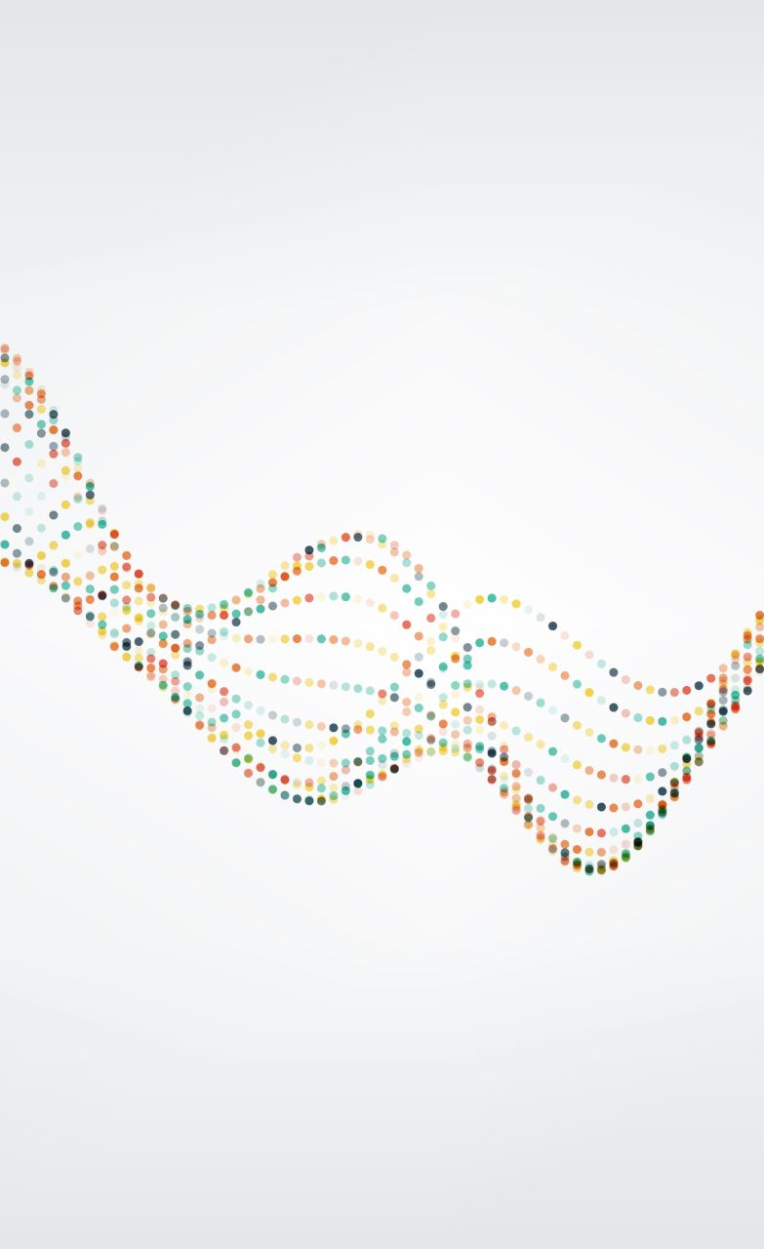
Evolution of sputtered particles steps
1. **Initialization**:
- Parameters such as target and substrate dimensions, number of particles, and camera dimensions are set.
- A list of particles is created, each with initial positions and velocities.
2. **Simulation Loop**:
- Each particle has a flag `operations` set to `True` to start the simulation loop.
- Inside the loop, the program checks if a collision occurs based on a random number and a threshold value.
- If no collision occurs, the particle's position is updated based on its current velocity.
- If a collision occurs, the particle's position and velocity are modified randomly.
- The program then checks if the particle is still within the simulation space. If it has left, `operations` is set to `False` to end the loop for this particle.
- If the particle has reached the substrate, the `objective` flag is set to `True`, and the count of successful hits is incremented.
- The trajectory of each particle is appended to result lists.
3. **Analysis**:
- After simulating all particles, the program calculates and prints the total number of successful hits and the percentage of particles that hit the substrate.

Slide 14
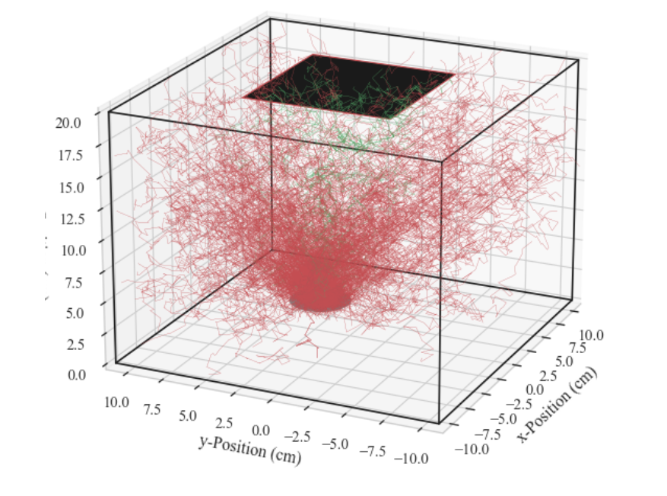
Particles which reached the target are colored green and others are red.

Slide 15
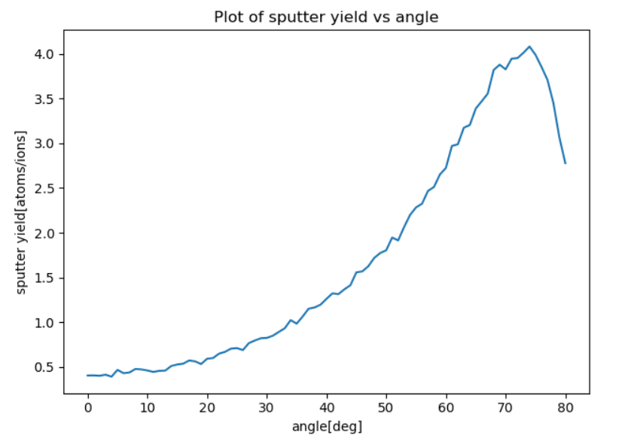
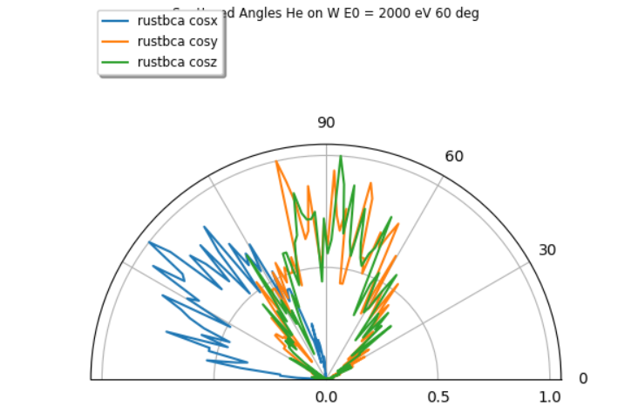
Comparison with widely used RustBCA model implementation

Slide 16
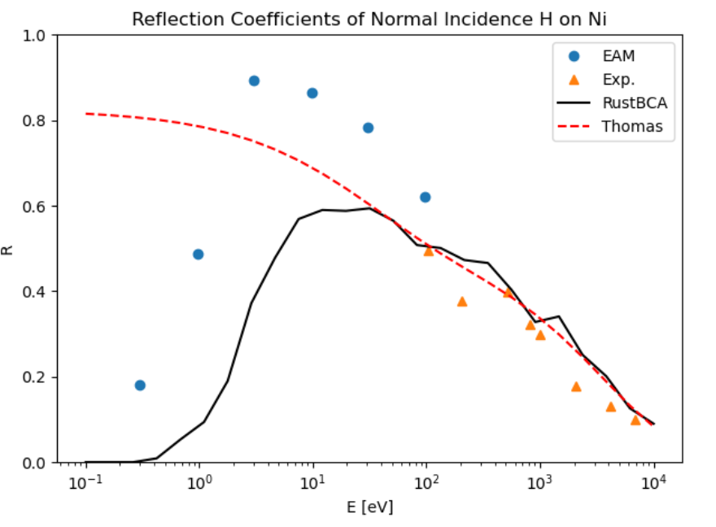
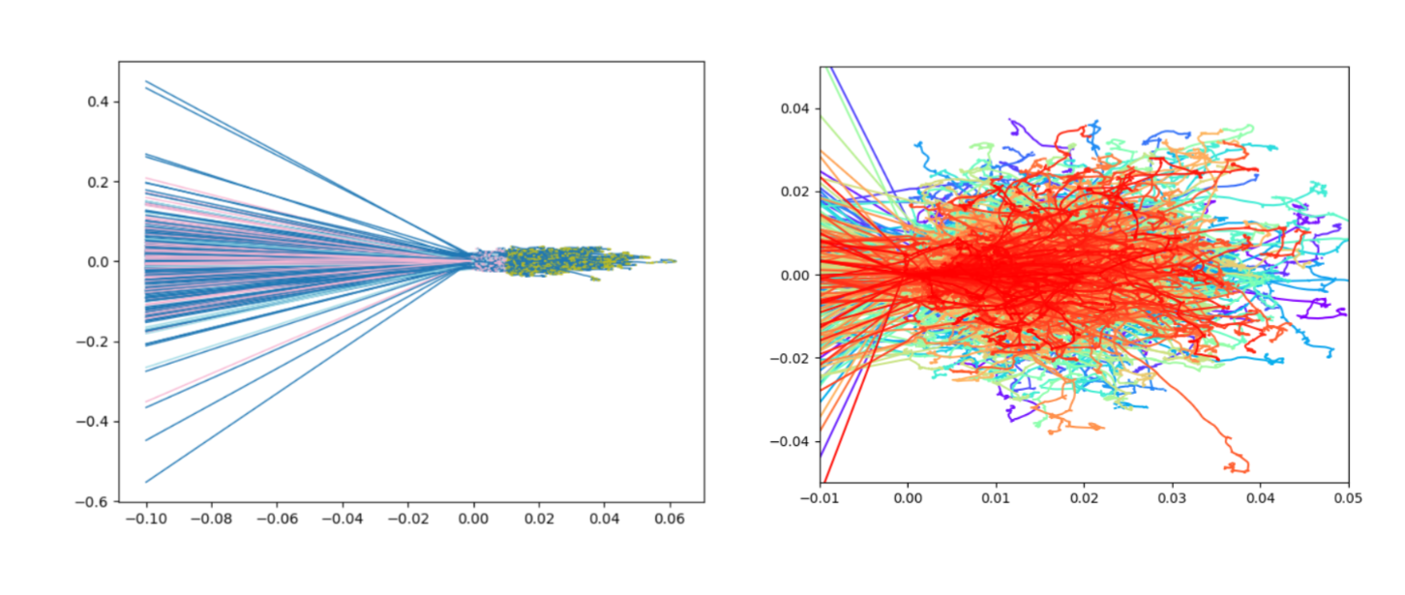
Advantages of RustBCA model
Rust is faster and efficient than Python.
More granularity.
Collision cascade and ion implantation has less approximations.

Slide 17
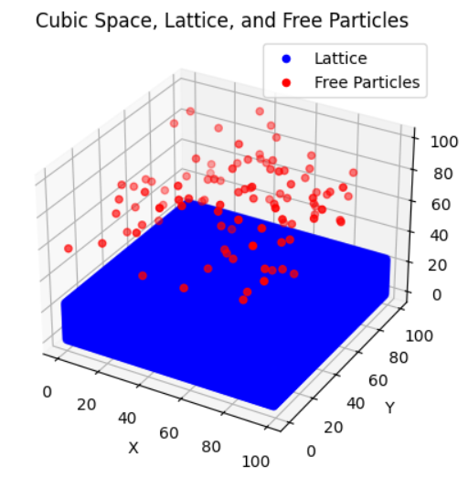
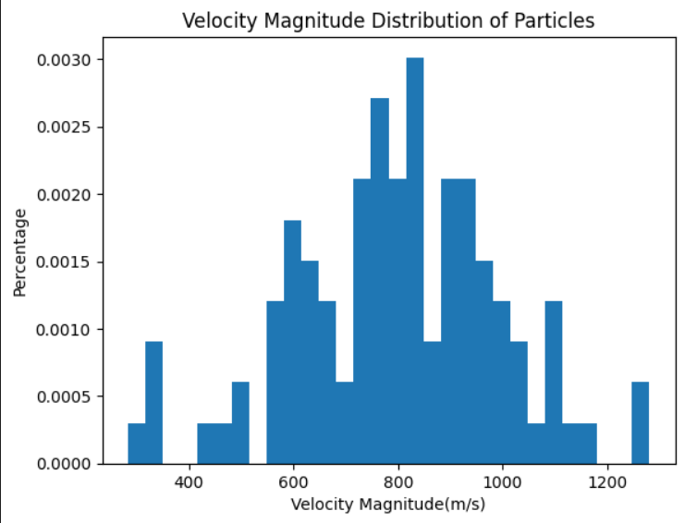
System initialize
Initialize velocities
3/2 k_bT
Binary collision
Collision cascade
Hamiltonian and MCMC
For ion-ion interactions
Simulation loop
Runs step 3 and 4 for one time step one after another
Static Dynamics Model

Slide 18
Advantages and considerations of such a model over static model
Handling Complex Interactions: The Metropolis-Hastings algorithm excels at handling complex interactions between ions, especially when these interactions are not simply binary. This capability allows for a more accurate representation of the system's behavior.
Efficient Sampling from Complex Distributions: In scenarios where the energy or spatial distribution of ions is complex and direct sampling is challenging, the Metropolis-Hastings algorithm efficiently samples from such distributions, providing valuable insights into the system's behavior.
Flexibility: The algorithm's flexibility enables it to adapt to a wide range of problems. It can effectively model any distribution that can be evaluated at a point, making it suitable for capturing the complexities of ion-ion interactions.
Preservation of Binary Collision Model: By integrating the Metropolis-Hastings algorithm for ion-ion interactions alongside the binary collision model for ion-metal interactions, the advantages of the binary collision model, such as computational efficiency and simplicity, are preserved. This hybrid approach leverages the strengths of both methods.
Considerations: It's essential to acknowledge that the Metropolis-Hastings algorithm can be computationally intensive compared to simpler methods. Therefore, its use should be justified by the complexity of the ion-ion interactions. The decision on the method should strike a balance between accuracy and computational efficiency.

Slide 19
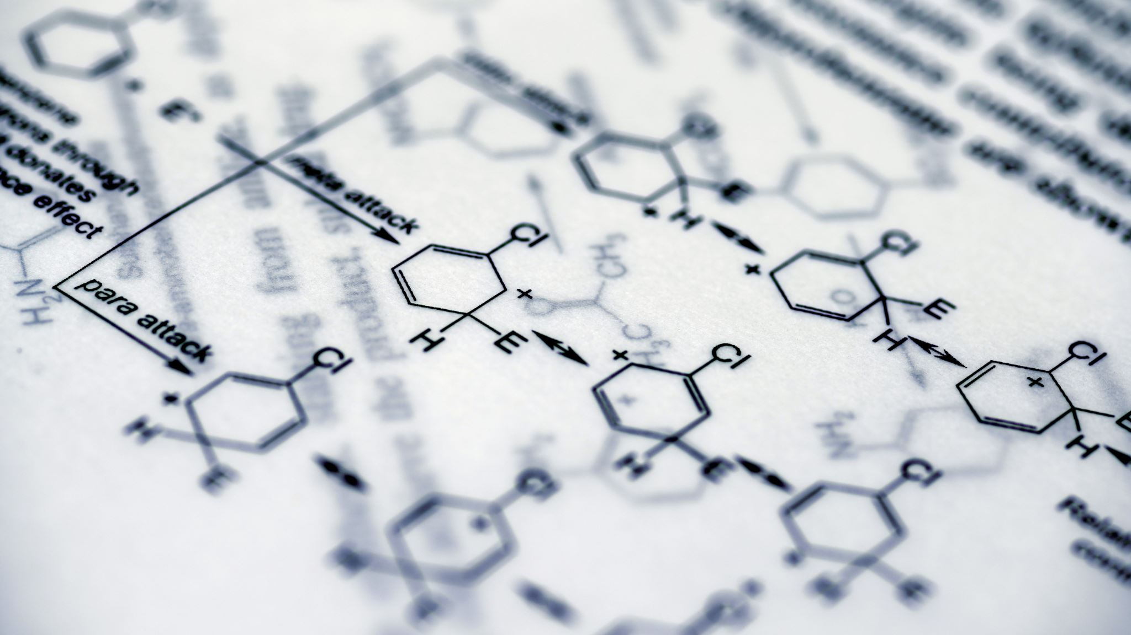
Simulations of ion beam sputtering processes are invaluable tools in research.
1. **Understanding Fundamental Mechanisms**: Simulations allow researchers to delve into the intricate details of ion beam sputtering at a fundamental level.
2. **Optimization of Process Parameters**: Ion beam sputtering simulations enable researchers to optimize various process parameters such as ion energy, angle of incidence, and substrate temperature. By systematically varying these parameters within the simulation, scientists can identify the conditions that lead to the desired sputtering outcomes, such as film thickness, uniformity, and surface morphology.
3. **Predicting Material Deposition**: Simulations can predict the deposition profile of sputtered material on substrates with different geometries and orientations. This capability is particularly useful in industries such as semiconductor manufacturing and thin film deposition, where precise control over film thickness and uniformity is critical.
4. **Designing Novel Materials and Structures**: By simulating ion beam sputtering processes, researchers can explore the feasibility of fabricating novel materials and nanostructures with tailored properties. These simulations aid in the design and optimization of advanced materials for various applications, including optics, electronics, and energy storage.

Slide 20
Thank You

